Slide 1
Lab 13 – Bitwise Ops
Bitwise ops, strtok, double pointers, review

Slide 2
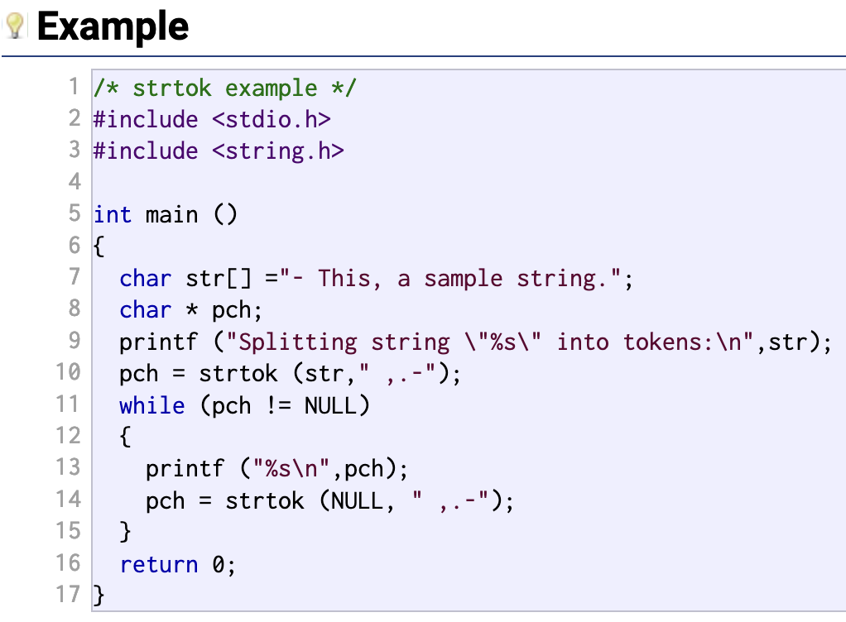
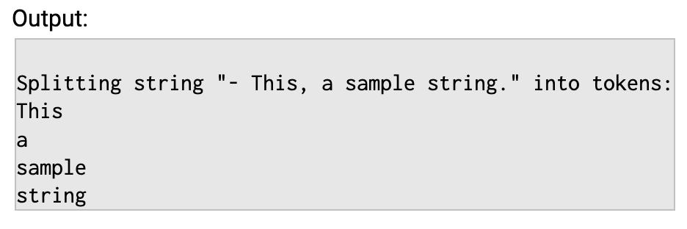
strtok (ex from cplusplus.com)

Slide 3
How strtok works (not thread safe)
It accepts a string (Param 1) and a delimiter (Param 2). Both are char *
Once the string is passed in the first round, we pass in NULL for future calls.
When we pass in null, it will use the last string it used
Param 1 is a static variable within strtok.
Param 2 should consist of the delims we want to look for. Note that if any one of the argued symbols are found, it will split.
strtok will return the string upto the symbol or the end of the string. If we reached the end previously, then NULL is returned and we should stop.
For example, strtok(“hi no dash”, “-”); will return “hi no dash” since “-” was not found.

Slide 4
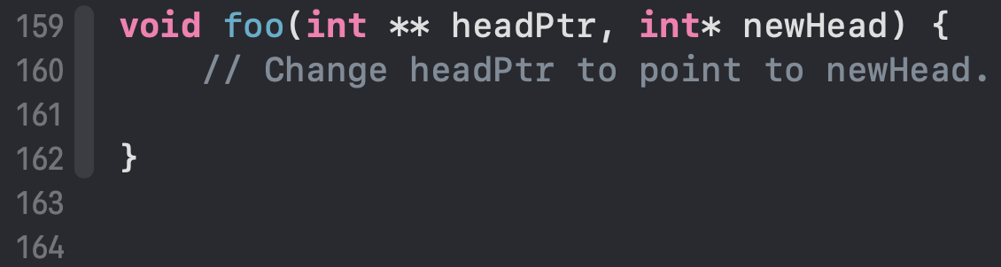
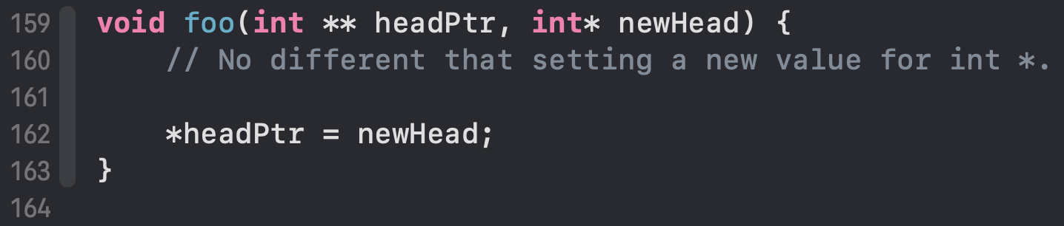
Using Double Pointers

Slide 5
Bitwise ops
(0101 1010 1110 ^ 0101 1110 1010)& (1011 0000 1111 | 0100 0101 0000)
| (BITWISE OR)
0 | 0 = 0 ||| 1 | 0 = 1
0 | 1 = 1 ||| 1 | 1 = 1
& (BITWISE AND)
0 & 0 = 0 ||| 1 & 0 = 0
0 & 1 = 0 ||| 1 & 1 = 1
^ (BITWISE XOR)
0 ^ 0 = 0 ||| 1 ^ 0 = 1
0 ^ 1 = 1 ||| 1 ^ 1 = 0
<< (Arithmetic shift left)
0000 1010 << 2 = 0010 1000 === 10 << 2 = 40
>> (Arithmetic shift right)
0011 0100 >> 2 = 0000 1101 === 52 >> 2 = 13
(0101 1010 1110
^ 0101 1110 1010)
& (1011 0000 1111
| 0100 0101 0000)
---------------
???? ???? ????

Slide 6
Questions?

Slide 7
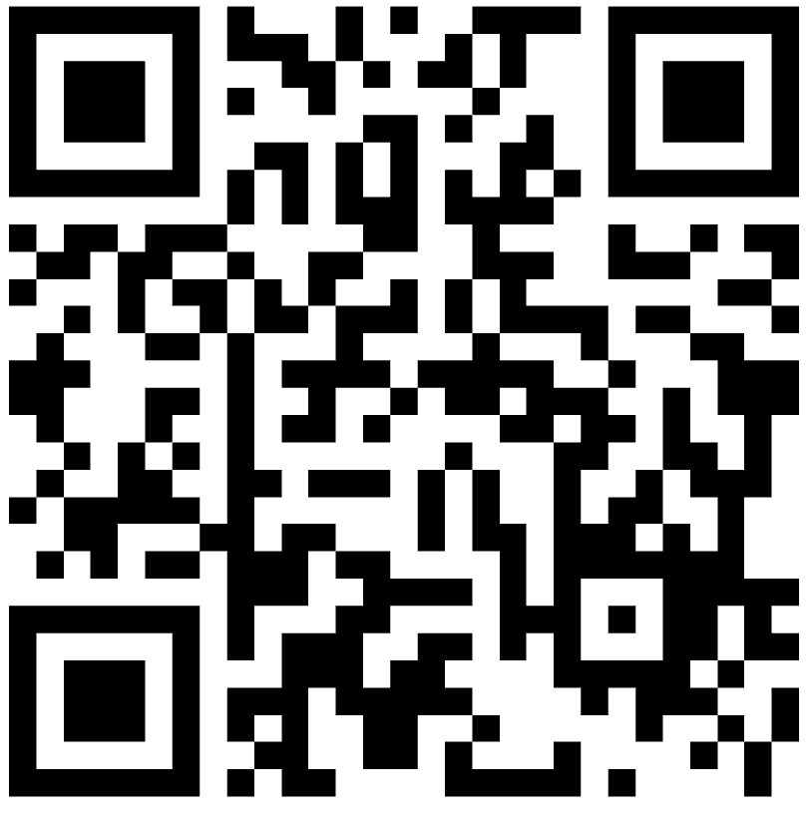
Exam Review
Sample Questions: https://forms.office.com/r/GKWbRri5K4

Slide 8
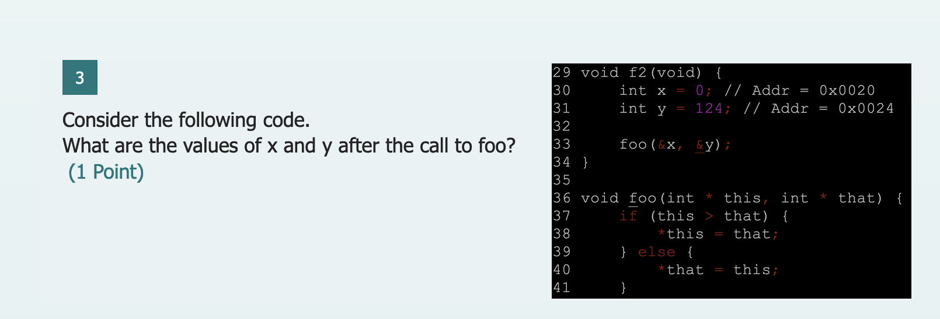
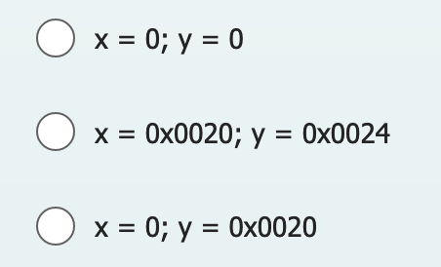
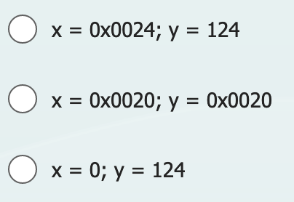
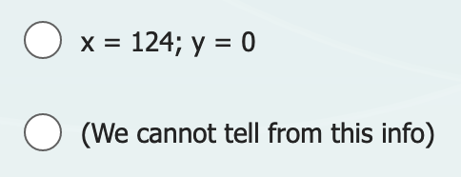
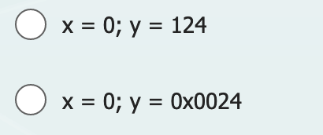
Understanding Levels of Indirection

Slide 9
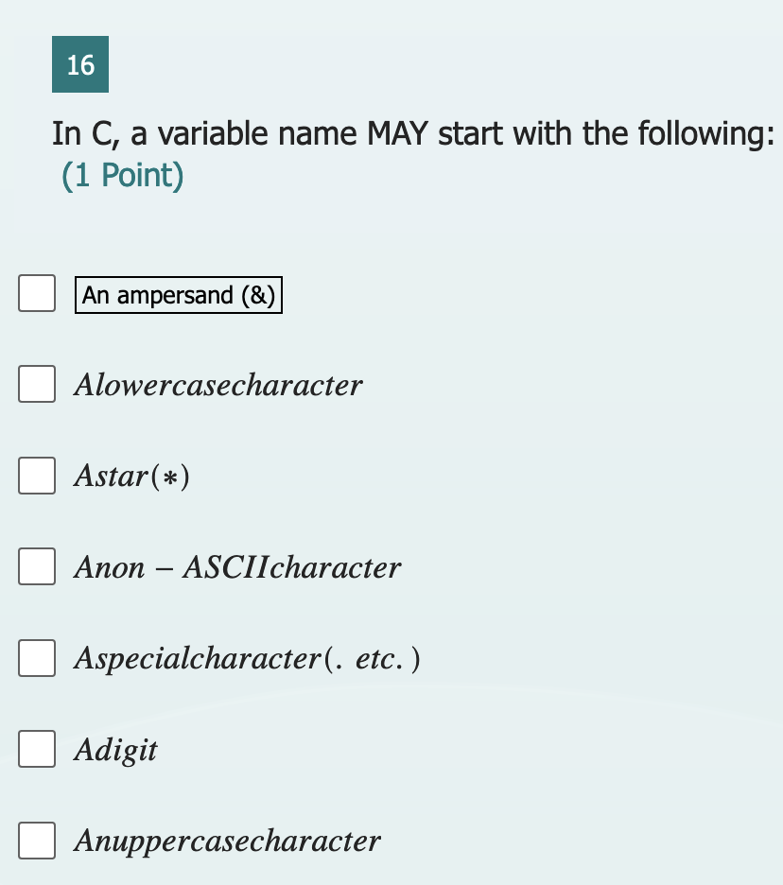

Slide 10
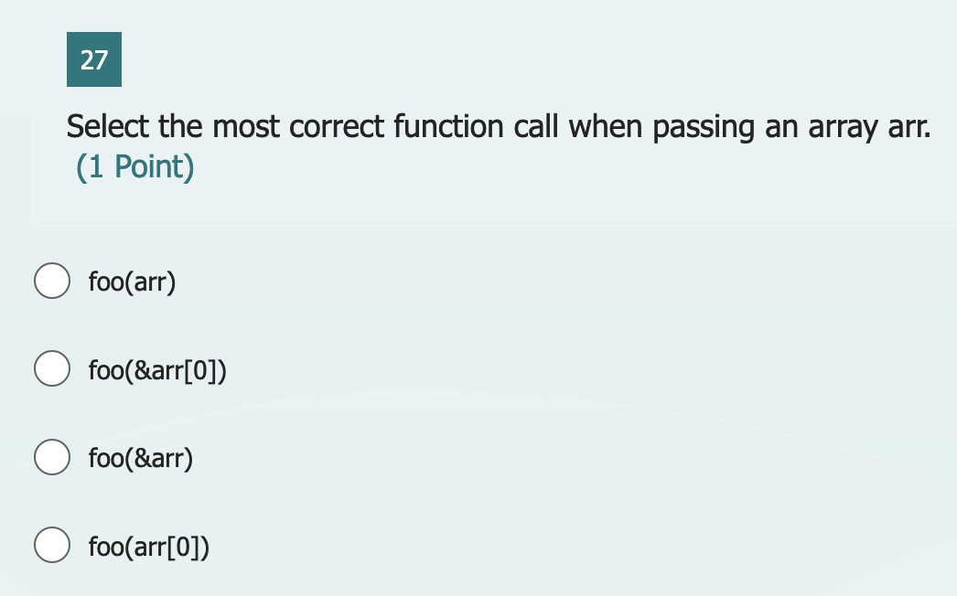

Slide 11
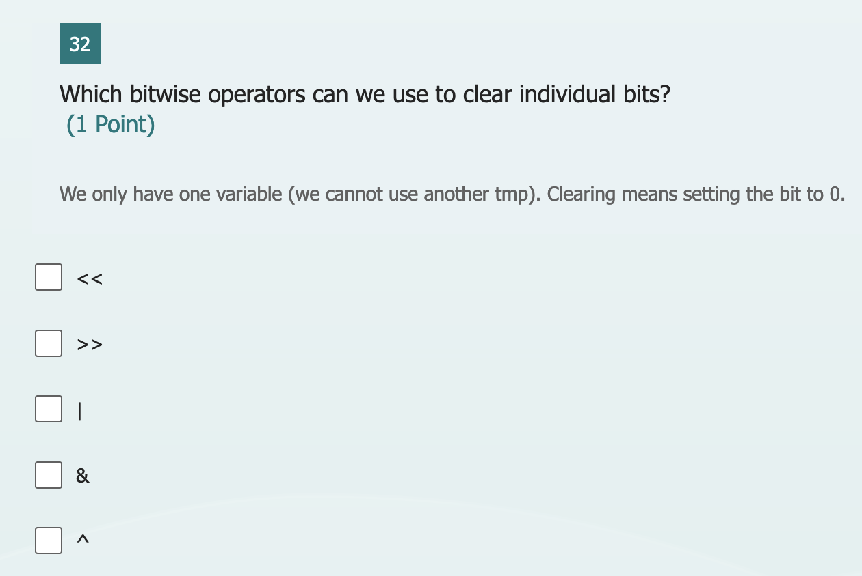

Slide 12
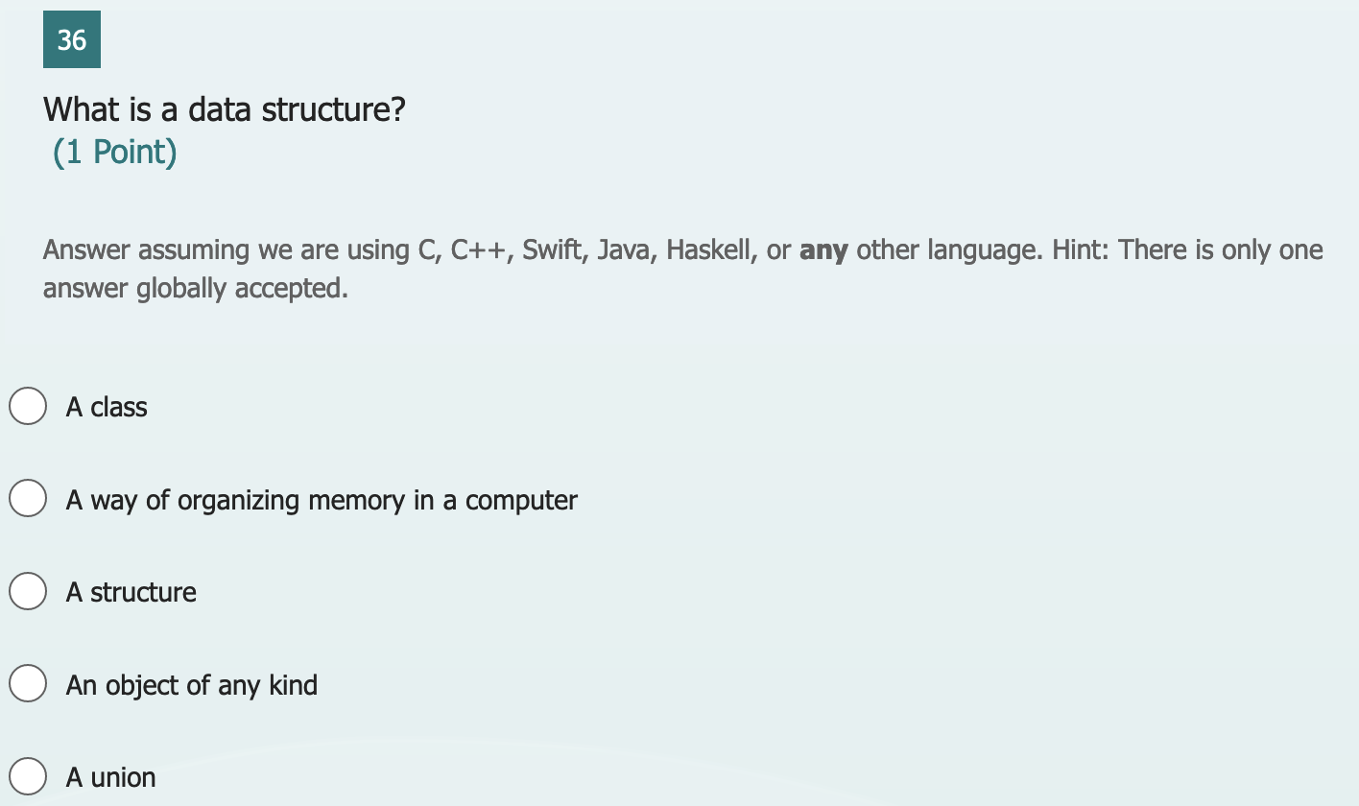

Slide 13
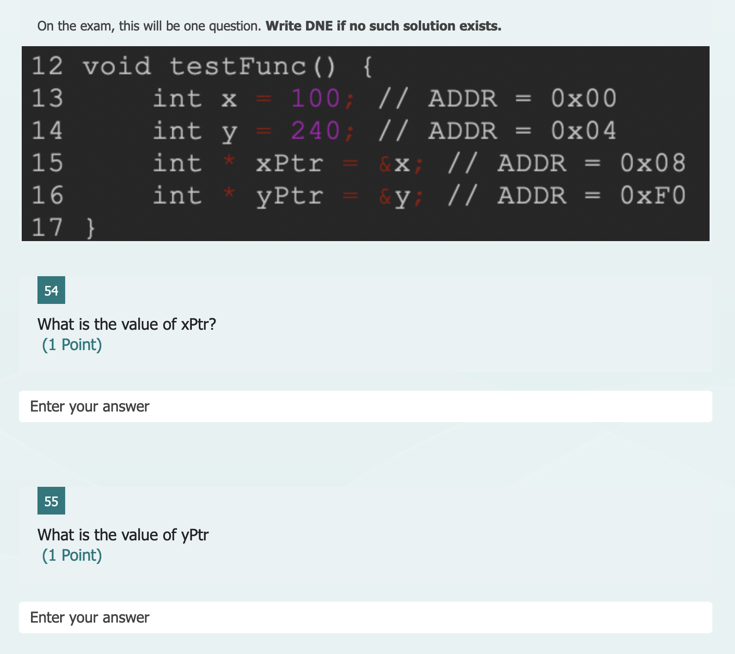

Slide 14
Be sure to look over the 3rd section of the quiz. It will help with understanding some of the harder problems. Note: The questions related to the given code may differ, but the overall idea is the same.

Slide 15
Lab Final
Review Lab 11
3 hours (normal time)
If the previous lab is still in here, it will not cut your time
If majority of people are working, you will get a few extra minutes
No notes, labs, or internet; ONLY the book! Digital or paper version ok!
The book can be time consuming! Do not rely on it!
No phones (I will allow music, but you cannot change it once we start)!
Project submission will be via USB Drive (USB A and C). Hand back the paper.
PUT YOUR NAME IN YOUR PROJECT AND YOUR PAPER! NO NAME = NO GRADE!
Failure of any steps = 0. The rules will be laid out on the handout
0 on Lab final = automatic fail, possibly with a report

Slide 16
Due Dates
PA 8 due Friday December 8th
Final grades are due around the 18th (I cannot recall the exact date)
All submissions or disagreements with grades are not accepted after the 8th.
You may reach out about PA 8 grades after they are posted, but do not delay!

